Slide 1
Digital Portfolio
STUDENT NAME: SAISUSI T
REGISTER NO AND NMID: astvu24924924u09033
DEPARTMENT: Bachelor of Computer Application
COLLEGE: SSS college for women, Arni
UNIVERSITY : Thiruvalluvar University

Slide 2
PROJECT TITLE
♠ Student Digital Portfolio

Slide 3


AGENDA
Problem Statement
Project Overview
End Users
Tools and Technologies
Portfolio design and Layout
Features and Functionality
Results and Screenshots
Conclusion
Github Link
3/21/2024 Annual Review

Slide 4

PROBLEM STATEMENT
☞ Students lack a proper digital platform to present their skills and projects.
☞ Traditional resumes are static and less interactive

Slide 5

PROJECT OVERVIEW
The student portfolio is a web-based system where students can create a digital profile.
It includes personal details , educational background, skills, certifications, projects and extracurricular activities.
The system provides an interactive and professional layout that acts as an online resume.

Slide 6

WHO ARE THE END USERS?
✿ Students— to showcase their skills and projects
✿ Teachers — to assess student growth.
✿ Recruiters — to review student profiles for jobs/internships

Slide 7

TOOLS AND TECHNIQUES
✧ Frontend:HTML/CSS/ JAVASCRIPT
✧ Backend:PHP/Node.js/Python
✧ Database : MySQL/MongoDB
✧ Version Control: GitHub

Slide 8
POTFOLIO DESIGN AND LAYOUT
◉ Home page: Student introduction and summary .
◉ About section: Personal details and Academic background.
◉ Skills Section : Technical and soft skills displayed with progress bars/charts.
◉ Project Section: Detailed showcase of student projects with Screenshots .
◉ Contact Section: Emails and Social media links.
8

Slide 9
FEATURES AND FUNCTIONALITY
♣ Upload project screenshots , Certificates and Resumes
♣ Responsive design for mobile and desktop
♣ Sharable portfolio link for recruiters
♣ Secure login and data storage

Slide 10

RESULTS AND SCREENSHOTS
♪ Screenshots of student profile page, project gallery and contact form.
♪ Demonstration of responsive layout on both desktop and mobile.
♪ Ex: portfolios created by test students
3/21/2024 Annual Review
10

Slide 11
CONCLUSION
• The student portfolio provides a modern, digital way for students to present their achievements
•It helps recruiters and institutions evaluate students beyond marks
•The system enhances employability and makes the recruitment /selection process easier
11

Slide 12
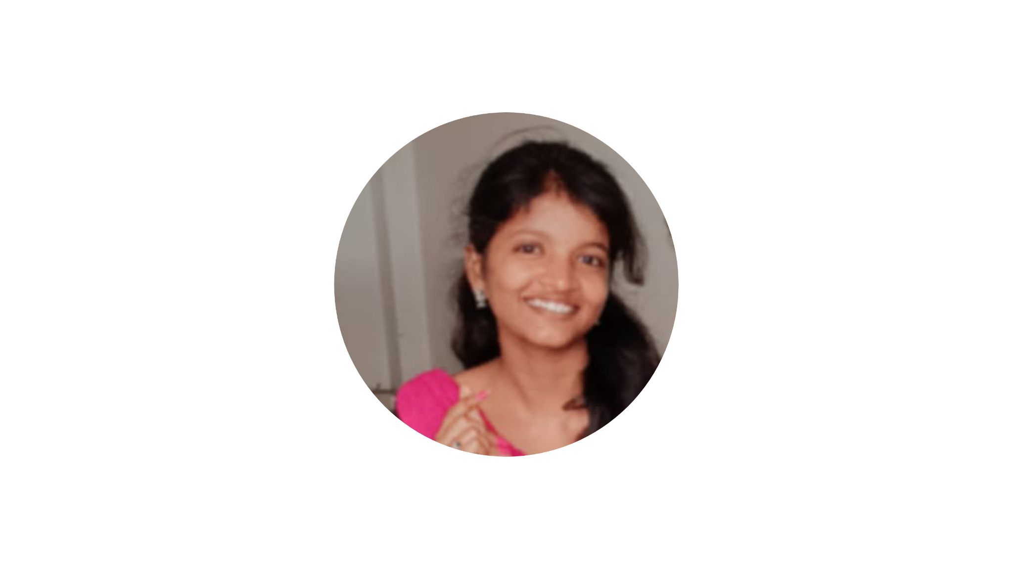
WEB LINK
https://github.com/saisusi-max/TNSDC-FWD-DP.git

